Slide 1
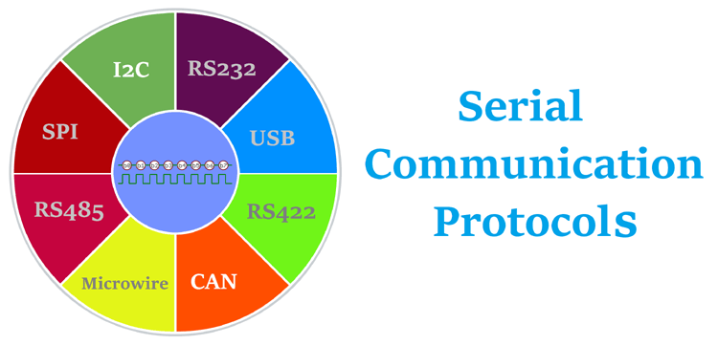
CSE360-Computer Interfacing BRAC University

Slide 2
Communication Protocol
According to Wikipedia, “A communication protocol is a system of rules that allow two or more entities of a Communication system to transmit information via any kind of variation of a physical quantity. The protocol defines the rules, syntax, semantics and synchronization of communication and possible error recovery methods. Protocols may be implemented by hardware, software, or a combination of both.”
Examples: SPI, I2C, UART, USB etc.

Slide 3
Serial Peripheral Interface (SPI)
.
SPI stands for Serial Peripheral Interface
Used for moving data simply and quickly from one device to another
Master-Slave(Multiple Slaves, Single Master)
Synchronous transmission
Synchronous- Data clocked with Clock Signal
Data Rate-10mbps
Full Duplex Protocol
Low power than I2C (no need of Pull ups)
Supports Single master and multiple slaves
No hardware slave acknowledgement

Slide 4
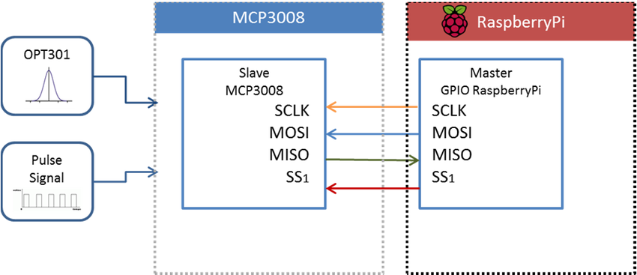
Master – Slave Protocol
.
Simple SPI Protocol Specifies 4 Signal Wires
1. Master Out Slave In (MOSI)
2. Master In Slave Out (MISO)
3. Serial Clock (SCLK)
4. Slave Select (SS)

Slide 5
Master – Slave Protocol
.
SPI is a Master-Slave protocol
The Master device controls the clock (SCK)
No data is transferred unless a clock signal is present
All slaves are controlled by the master clock
The slave devices may not manipulate the clock
Master Set Slave Select low
Master Generates Clock
Shift registers shift in and out data Master Slave SCLK MOSI MISO SS

Slide 6
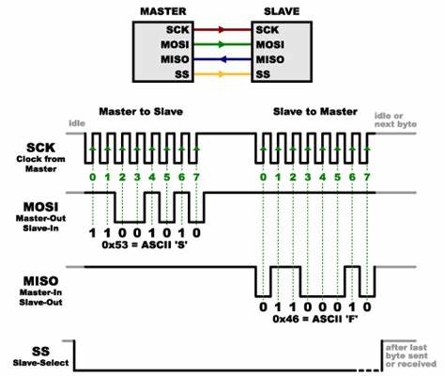
How SPI Works
.
Single master – single slave

Slide 7
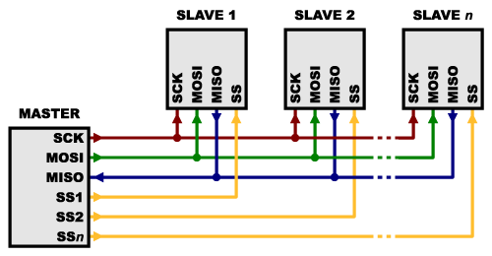
How SPI Works
.
Single master – Multiple slaves

Slide 8
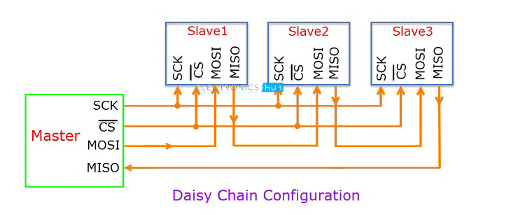
How SPI Works
.
Single master – Multiple slaves

Slide 9
How SPI Works
.
In summary the steps of SPI:
1. The master outputs the clock signal
2. The master switches the SS/CS pin to a low voltage state, which activates the slave
3. The master sends the data one bit at a time to the slave along the MOSI line. The slave reads the bits as they are received
4. If a response is needed, the slave returns data one bit at a time to the master along the MISO line. The master reads the bits as they are received

Slide 10
SPI
.
Advantages:
Full duplex protocol. Separate MISO and MOSI lines, so data can be sent and received at the same time
No start and stop bits, so the data can be streamed continuously without interruption
No complicated slave addressing system like I2C
Higher data transfer rate than I2C (almost twice as fast)
Not Limited to 8 bit words in case of bit transferring
Arbitrary choice of message size, content and Purpose
Low Power

Slide 11
SPI
.
Disadvantages:
Requires more pins than I2C
No hardware flow control
No Slave Acknowledgement
Multi Master Difficult to Implement
No form of error checking like the parity bit in UART
It usually requires separate SS lines to each slave, which can be problematic if numerous slaves are needed.

Slide 12
SPI
.
SPI Peripherals:
Converters (ADC, DAC)
Memories (EEPROM, RAM’s, Flash)
Sensors (Temperature, Humidity, Pressure)
Real Time Clocks
Misc.- Potentiometers, LCD controllers, UART’s, USB controller, CAN controller, amplifiers

Slide 13

.

Slide 14
UART
.
Introduction:
Universal Asynchronous Receiver/Transmitter
It also called Serial Communication Interface(SCI)
Full-duplex communication.
Asynchronous communication.
Compatible with PC .
The Standard bit rates are: 100, 200, 300, 1200, 2400, 4800, 9600, 19200, 38400, 57600, 115200 bps.
Example: Connecting GPS modules, Bluetooth modules, and RFID card reader modules to Raspberry Pi, Arduino, or other microcontrollers.

Slide 15
UART
.
A UART’s main purpose is to transmit and receive serial data.
One of the best things about UART is that it only uses two wires to transmit data between devices
Why UART?
A UART may be used when:-
High speed is not required
An inexpensive communication link between two devices is required.
UART communication is very cheap:-
Single wire for each direction(and ground wire).
Simple hardware.

Slide 16
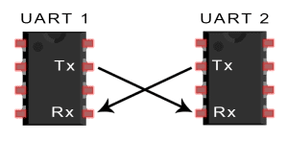
UART
.
In UART communication, two UARTs communicate directly with each other. Data flows from the Tx pin of the transmitting UART to the Rx pin of the receiving UART:

Slide 17
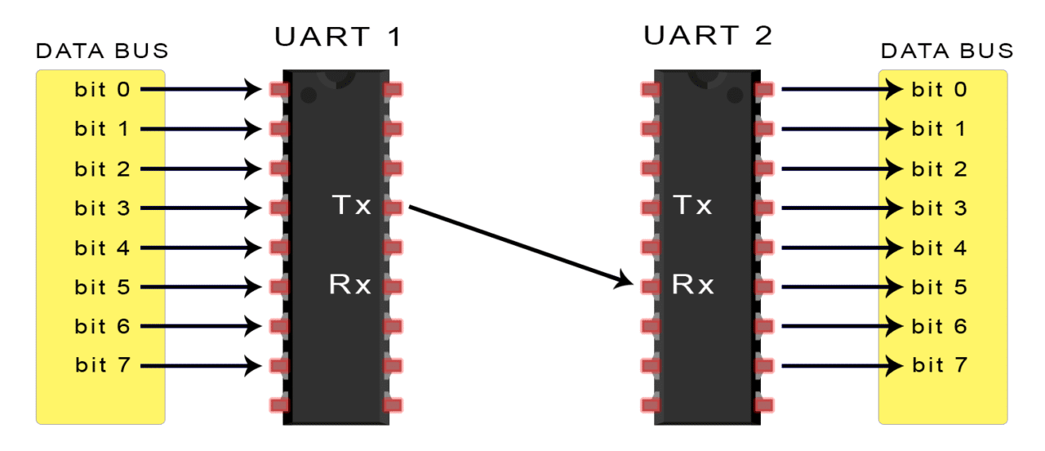
UART
.

Slide 18
UART
.
The transmitting UART converts parallel data from a controlling device like a CPU into serial form, transmits it in serial to the receiving UART, which then converts the serial data back into parallel data for the receiving device.
The UART that is going to transmit data receives the data from a data bus. The data bus is used to send data to the UART by another device like a CPU, memory, or microcontroller. Data is transferred from the data bus to the transmitting UART in parallel form. After the transmitting UART gets the parallel data from the data bus, it adds a start bit, a parity bit, and a stop bit, creating the data packet.

Slide 19
UART
.
Next, the data packet is output serially, bit by bit at the Tx pin. The receiving UART reads the data packet bit by bit at its Rx pin. The receiving UART then converts the data back into parallel form and removes the start bit, parity bit, and stop bits. Finally, the receiving UART transfers the data packet in parallel to the data bus on the receiving end.
When the receiving UART detects a start bit, it starts to read the incoming bits at a specific frequency known as the baud rate. Baud rate is a measure of the speed of data transfer, expressed in bits per second (bps).
Both UARTs must operate at about the same baud rate. The baud rate between the transmitting and receiving UARTs can only differ by about 10% before the timing of bits gets too far off.

Slide 20
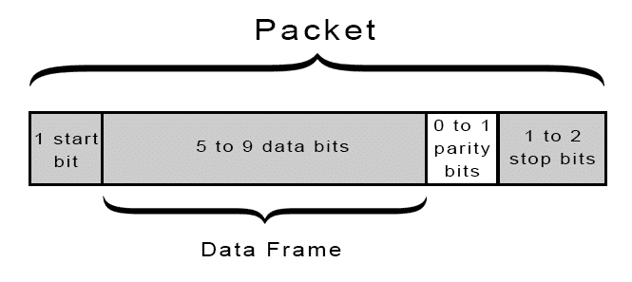
How UART Communicate?
.
START BIT: The UART data transmission line is normally held at a high voltage level when it’s not transmitting data.
To start the transfer of data, the transmitting UART pulls the transmission line from high to low for one clock cycle.
When the receiving UART detects the high to low voltage transition, it begins reading the bits in the data frame at the frequency of the baud rate.

Slide 21
How UART Communicate?
.
DATA FRAME: The data frame contains the actual data being transferred. It can be 5 bits up to 8 bits long if a parity bit is used.
If no parity bit is used, the data frame can be 9 bits long. In most cases, the data is sent with the least significant bit first.

Slide 22
How UART Communicate?
.
PARITY: Parity describes the evenness or oddness of a number.
The parity bit is a way for the receiving UART to tell if any data has changed during transmission(Bits can be changed by electromagnetic radiation, mismatched baud rates, or long distance data transfers).
After the receiving UART reads the data frame, it counts the number of bits with a value of 1 and checks if the total is an even or odd number.
If the parity bit is a 0 (even parity), the 1 bits in the data frame should total to an even number. If the parity bit is a 1 (odd parity).

Slide 23
How UART Communicate?
.
STOP BITS: To signal the end of the data packet, the sending UART drives the data transmission line from a low voltage to a high voltage for at least two bit durations

Slide 24
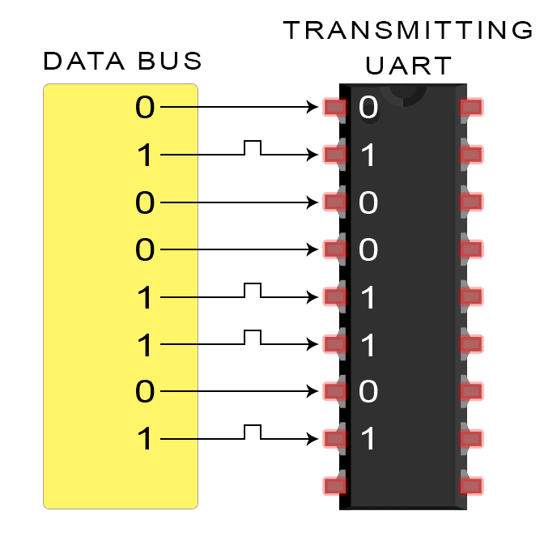
STEPS OF UART TRANSMISSION
.
The transmitting UART receives data in parallel from the data bus.

Slide 25
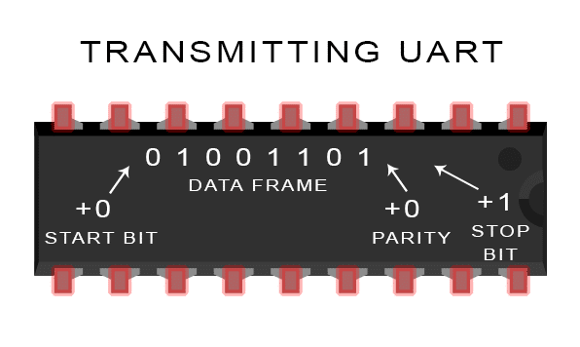
STEPS OF UART TRANSMISSION
.
The transmitting UART adds the start bit, parity bit, and the stop bit(s) to the data frame.

Slide 26
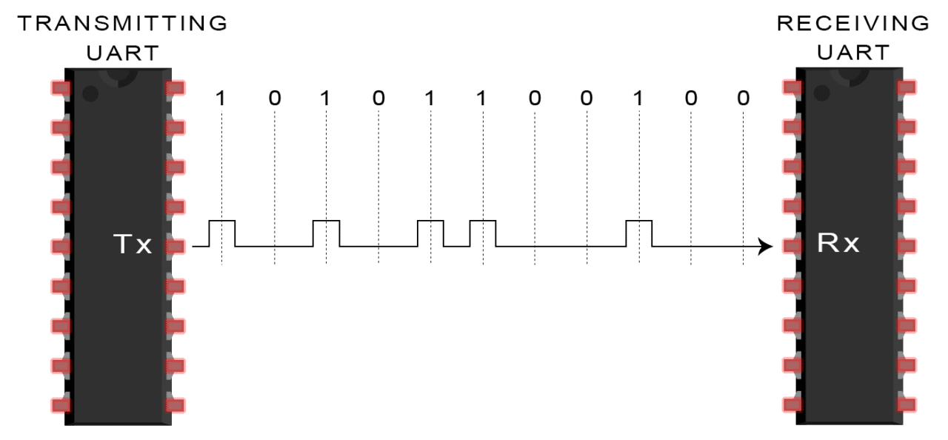
STEPS OF UART TRANSMISSION
.
The entire packet is sent serially from the transmitting UART to the receiving UART. The receiving UART samples the data line at the pre-configured baud rate.

Slide 27
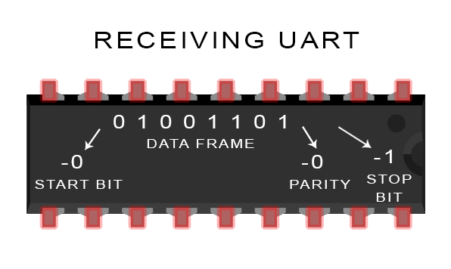
STEPS OF UART TRANSMISSION
.
The receiving UART discards the start bit, parity bit, and stop bit from the data frame.

Slide 28
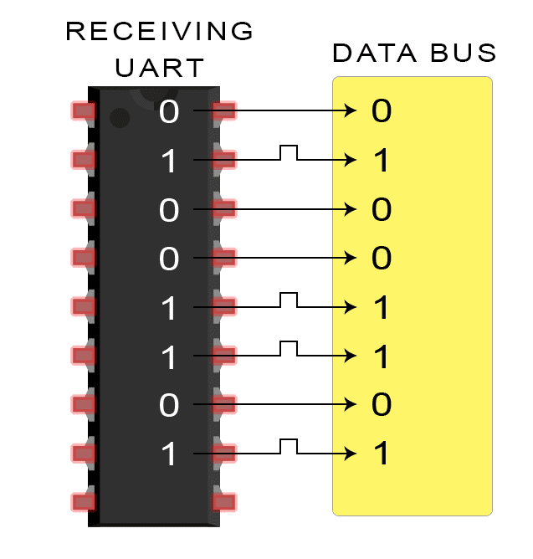
STEPS OF UART TRANSMISSION
.
The receiving UART converts the serial data back into parallel and transfers it to the data bus on the receiving end.

Slide 29
UART
.
ADVANTAGES
Only uses two wires
No clock signal is necessary
Has a parity bit to allow for error checking
The structure of the data packet can be changed as long as both sides are set up for it
Well documented and widely used method
DISADVANTAGES
The size of the data frame is limited to a maximum of 9 bits
Doesn’t support multiple slave or multiple master systems

Slide 30

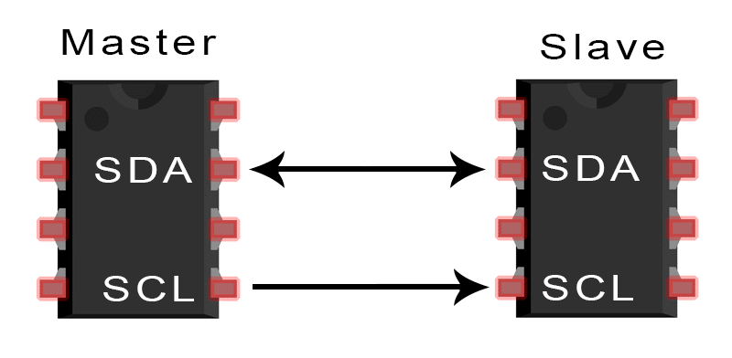

Slide 31
I2C Bus
I2C is not only used on single boards but also to connect components which are linked via cable. Simplicity and flexibility are key characteristics that make this bus attractive to many applications.
Most significant features include:
Only two bus lines are required: SDA (Serial Data), SCL (Serial Clock)
No strict baud rate requirements like for instance with RS232, the master generates a bus clock
Simple master/slave relationships exist between all components Each device connected to the bus is software-addressable by a unique address
I2C is a true multi-master bus providing arbitration and collision detection

Slide 32

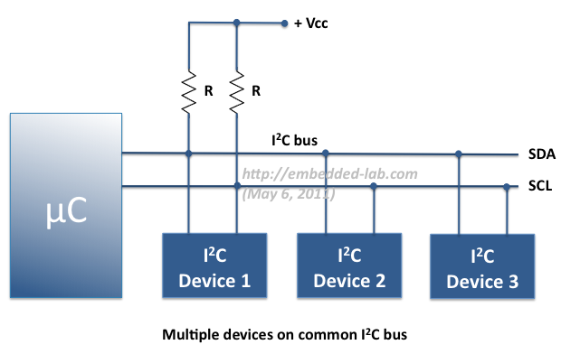

Slide 33
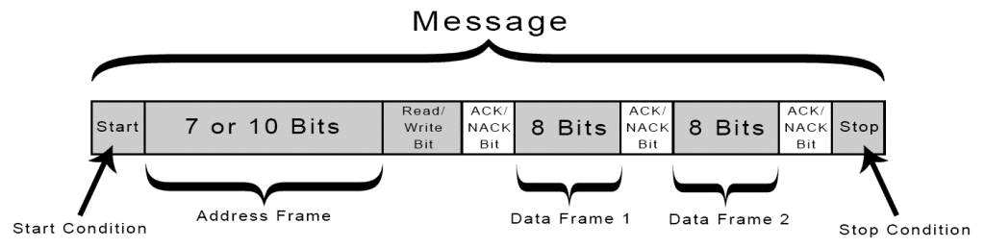

Slide 34
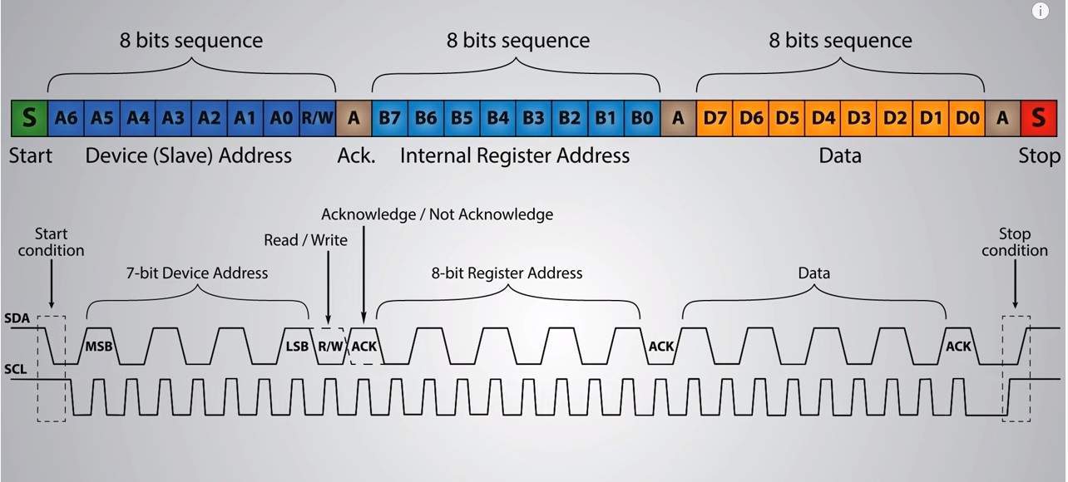

Slide 35

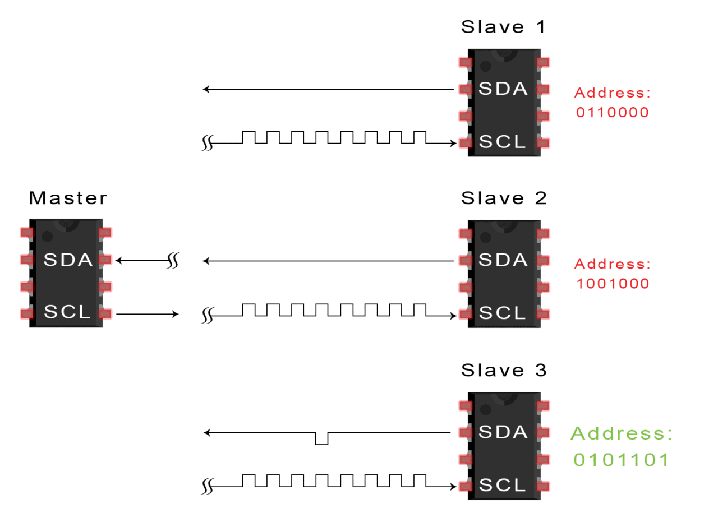
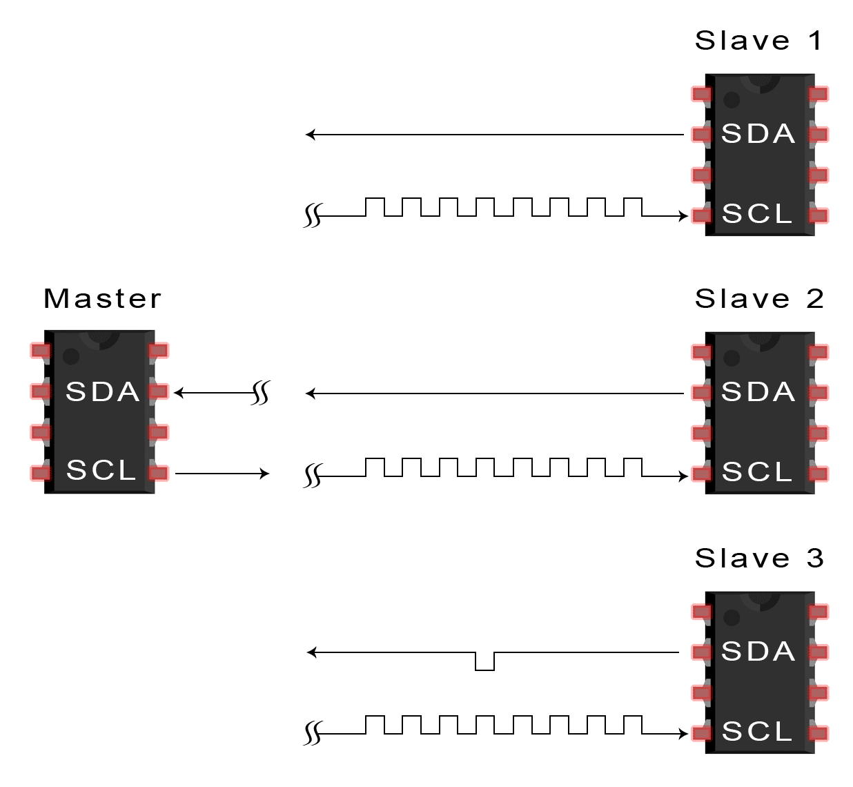

Slide 36
I2C Bus
I2C Protocol (Basics) Messages are broken up into two types of frame:
• Address frame: The master indicates the slave to which the message is being sent
• Data frame: These are 8-bit data messages passed from master to slave or vice versa.
Data is placed on the SDA line after SCL goes low, and is sampled after the SCL line goes high.

Slide 37
I2C Bus
Start Condition
• To initiate the address frame, the master device leaves SCL high and pulls SDA low.
• This puts all slave devices on notice that a transmission is about to start.
• If two master devices wish to take ownership of the bus at one time, whichever device pulls SDA low first wins the race and gains control of the bus.
• It is possible to issue repeated starts, initiating a new communication sequence without relinquishing control of the bus to other masters

Slide 38
I2C Bus
Address Frame
• The address frame is always first in any new communication sequence.
• For a 7-bit address, the address is clocked out most significant bit (MSB) first, followed by a R/W bit indicating whether this is a read (1) or write (0) operation.

Slide 39
I2C Bus
NACK/ACK bit
• It is the 9th bit of the frame
• This is the case for all frames (data or address).
• Once the first 8 bits of the frame are sent, the receiving device is given control over SDA.
• If the receiving device does not pull the SDA line low before the 9th clock pulse, it can be inferred that the receiving device either did not receive the data or did not know how to parse the message. • In that case, the exchange halts, and it’s up to the master of the system to decide how to proceed.

Slide 40
I2C Bus
Data Frames
• After the address frame has been sent, data can begin being transmitted.
• The master will simply continue generating clock pulses at a regular interval, and the data will be placed on SDA by either the master or the slave, depending on whether the R/W bit indicated a read or write operation.
Stop condition
• Once all the data frames have been sent, the master will generate a stop condition.
• Stop conditions are defined by a 0->1 (low to high) transition on SDA after a 0->1 transition on SCL, with SCL remaining high.
• During normal data writing operation, the value on SDA should not change when SCL is high, to avoid false stop conditions.
.

Slide 41
STEPS OF I2C DATA TRANSMISSION
1. The master sends the start condition to every connected slave by switching the SDA line from a high voltage level to a low voltage level before switching the SCL line from high to low.
2. The master sends each slave the 7 or 10 bit address of the slave it wants to communicate with, along with the read/write bit.
3. Each slave compares the address sent from the master to its own address. If the address matches, the slave returns an ACK bit by pulling the SDA line low for one bit. If the address from the master does not match the slave’s own address, the slave leaves the SDA line high.
4. The master sends or receives the data frame.
5. After each data frame has been transferred, the receiving device returns another ACK bit to the sender to acknowledge successful receipt of the frame.
6. To stop the data transmission, the master sends a stop condition to the slave by switching SCL high before switching SDA high.

Slide 43
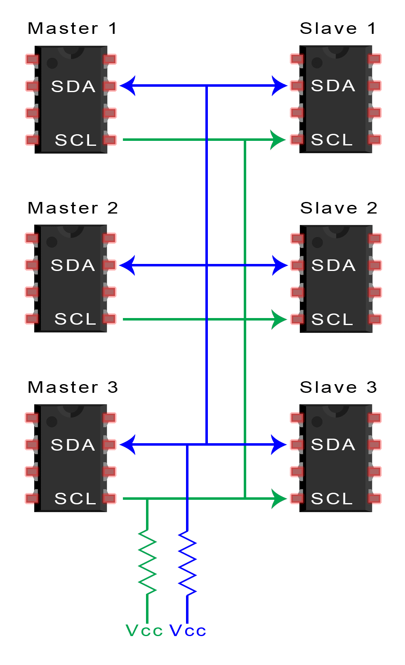
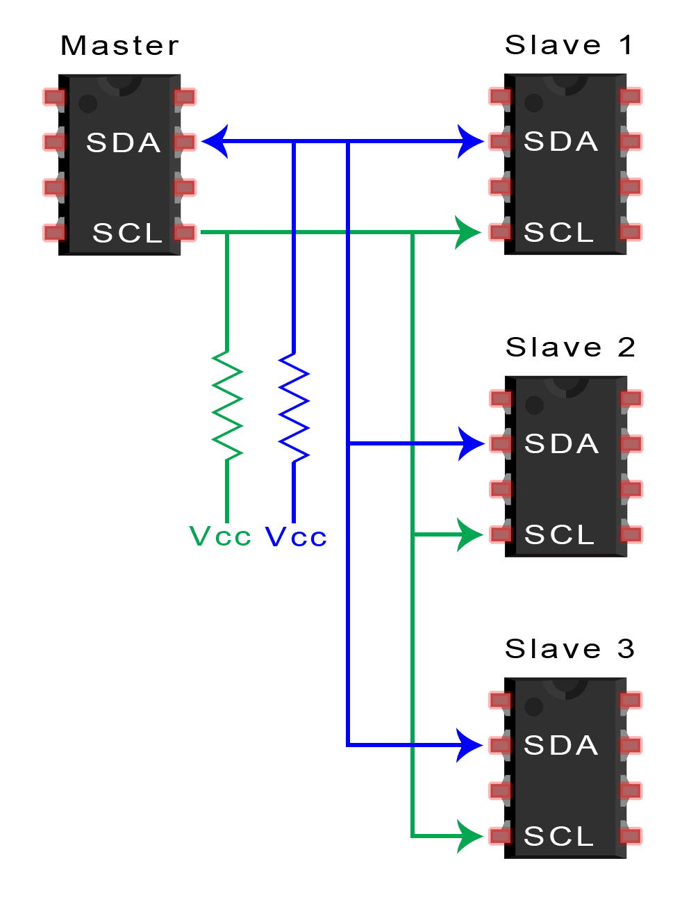
Single Master – Multiple Slave
Multiple Master – Multiple Slave

Slide 44
Advantages
I2C communication or protocol has a significant edge over its peers such as serial port communication and SPI. Let us have a look into the various advantages that renders the I2C protocol so effective for short distance intra-board communication.
1. Flexibility – The I2C protocol supports multi-master, multi-slave communication, which implies you can add a lot of functionality to your design. More than one master IC controlling and communicating with the slave ICs can speed things up and add functionalities to the embedded system.
2. Addressing feature – Yet another advantage of the I2C protocol lies in its inherent ability to use chip addressing. It means that you can easily add components to the bus without any complexity. It eliminates the necessity of CS (chip select) lines.
3. Simplicity – I2C protocol doesn’t complicate the design. It requires only two bidirectional signal lines to establish communication among multiple devices. Further, the pin count is low as well.
4. Better error handling mechanism – To improve the error detection and correction mechanism, the I2C protocol relies on ACK/NACK feature, which is a robust error correction feature. ACK stands for Acknowledgement whereas NACK means No Acknowledgement.
5. Adaptable – The I2C protocol is adaptable in the sense that it can work well with both slow ICs and fast ICs.

Slide 45
Disadvantages
1. Conflicts – Due to chip addressing, there’s always a possibility of an address conflict.
2. Slower speeds – Slower data transfer rate than SPI
3. Requires more space – More complicated hardware needed to implement than SPI
4. Size of Data Frame - Limited to 8 bits.

Slide 46
.
Thank You For Your Attention

